Slide 1
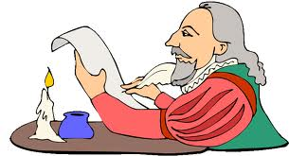
Introduction to Poetry!

Slide 2
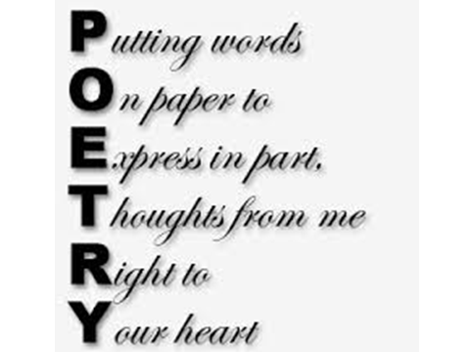

Slide 3
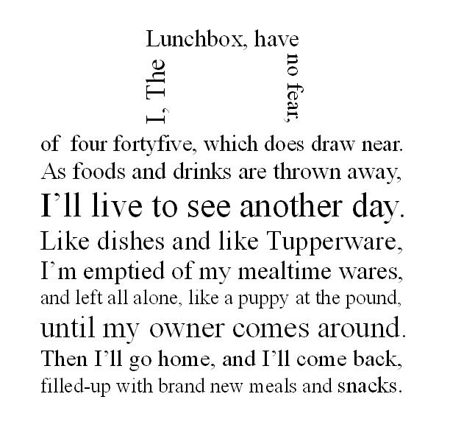
Poetry is a type of literature in which words are chosen and arranged to create a specific effect.

Slide 4
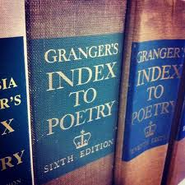
Structure and
Sound Devices
PART I
Imagery and
Figurative Language
PART II
Types of Poems
PART III

Slide 5
Structure and Sound Devices
PART I

Slide 6
Line: the simplest part of a poem; used instead of sentences.
O Captain! My Captain! our fearful trip is done; The ship has weather'd every rack, the prize we sought is won; The port is near, the bells I hear, the people all exulting, While follow eyes the steady keel, the vessel grim and daring:
But O heart! heart! heart!
O the bleeding drops of red,
Where on the deck my Captain lies,
Fallen cold and dead.
O Captain! my Captain! rise up and hear the bells; Rise up—for you the flag is flung—for you the bugle trills; For you bouquets and ribbon'd wreaths—for you the shores a-crowding; For you they call, the swaying mass, their eager faces turning;
O captain! dear father!
This arm beneath your head;
It is some dream that on the deck,
You've fallen cold and dead.
My Captain does not answer, his lips are pale and still; My father does not feel my arm, he has no pulse nor will; The ship is anchor'd safe and sound, its voyage closed and done; From fearful trip, the victor ship, comes in with object won;
Exult, O shores, and ring, O bells!
But I, with mournful tread,
Walk the deck my captain lies,
Fallen cold and dead.

Slide 7
Stanza: a group of lines.
O Captain! My Captain! our fearful trip is done; The ship has weather'd every rack, the prize we sought is won; The port is near, the bells I hear, the people all exulting, While follow eyes the steady keel, the vessel grim and daring:
But O heart! heart! heart!
O the bleeding drops of red,
Where on the deck my Captain lies,
Fallen cold and dead.
O Captain! my Captain! rise up and hear the bells; Rise up—for you the flag is flung—for you the bugle trills; For you bouquets and ribbon'd wreaths—for you the shores a-crowding; For you they call, the swaying mass, their eager faces turning;
O captain! dear father!
This arm beneath your head;
It is some dream that on the deck,
You've fallen cold and dead.
My Captain does not answer, his lips are pale and still; My father does not feel my arm, he has no pulse nor will; The ship is anchor'd safe and sound, its voyage closed and done; From fearful trip, the victor ship, comes in with object won;
Exult, O shores, and ring, O bells!
But I, with mournful tread,
Walk the deck my captain lies,
Fallen cold and dead.

Slide 8
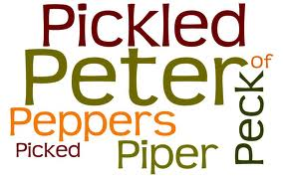
Alliteration: is the repetition of consonant sounds, most often at the beginning of nearby words and syllables.

Slide 9
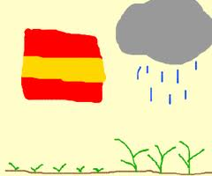
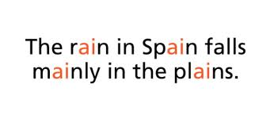
Assonance: is the repetition of vowel sounds in nearby words.

Slide 10
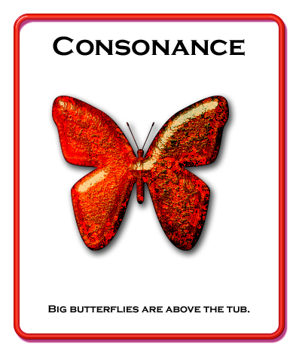
Consonance: A pleasing combination of sounds; refers to repetition of consonant sounds in stressed syllables.

Slide 11
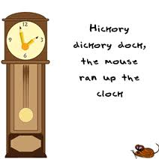
End Rhyme: is when words rhyme at the ends of lines.

Slide 12
Internal Rhyme: is when words rhyme in the middle of lines.
For the moon never beams without bringing me dreams
Of the beautiful Annabel Lee;
And the stars never rise but I feel the bright eyes
Of the beautiful Annabel Lee;
And so, all the night-tide, I lie down by the side
Of my darling, my darling, my life and my bride,
In the sepulchre there by the sea,
In her tomb by the sounding sea.

Slide 13
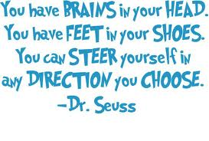
Meter: is a regular pattern of rhythm.

Slide 14
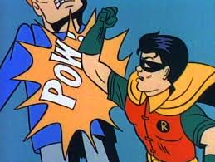
Onomatopoeia: is a word or phrase that imitates the sound of what it describes.

Slide 15
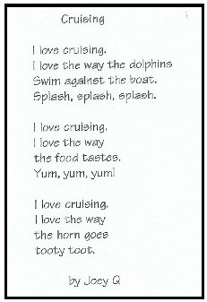
Repetition: is the use of a word, phrase, line, or sound more than once in a poem.

Slide 16
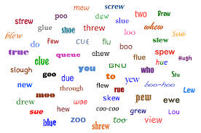
Rhyme: is the repetition of identical or similar sounds at the ends of words.

Slide 17
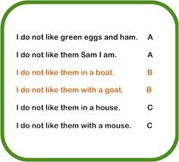
Rhyme Scheme: is the pattern formed by end rhymes.

Slide 18
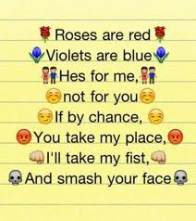
Rhythm: is the pattern of stressed and unstressed syllables in a poem.

Slide 19
Speaker: The voice of a poem.

Slide 20
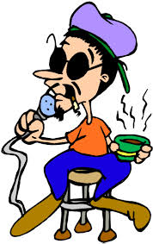
½ WAY POINT!

Slide 21
Imagery and Figurative Language
PART II

Slide 22
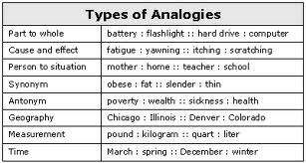
Analogy: A “visual” comparison between 2 things based on one or more elements they share.

Slide 23
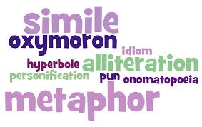
Figurative Language: Language used for descriptive effect, often to imply ideas indirectly.

Slide 24
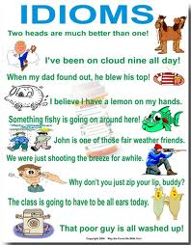
Idiom: An expression, specific to a language, people, or culture, where the whole meaning does not equal the sum of its parts.

Slide 25
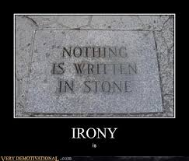
Irony: A form of expression in which the intended meaning of the words used is the opposite of their literal meaning.

Slide 26
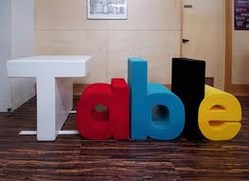
Literal: True or real.

Slide 27
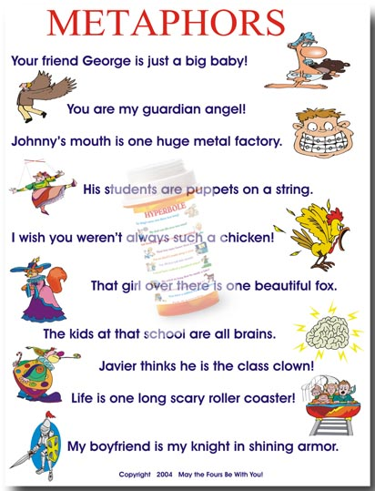
Metaphor: A comparison of 2 unlike things not using like or as.

Slide 28
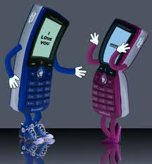
Personification: Describing an animal or object as human or having human qualities.

Slide 29
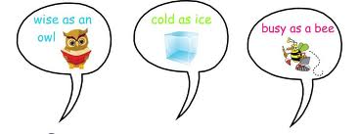
Simile: A comparison of 2 unlike things using like or as.

Slide 30
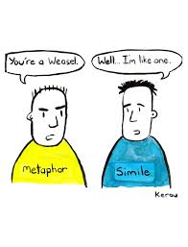
Just a reminder: the difference between metaphor and simile...

Slide 31
Types of Poems
PART III

Slide 32
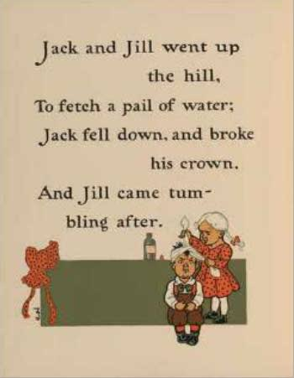
Ballad: A short musical narrative song or poem.

Slide 33
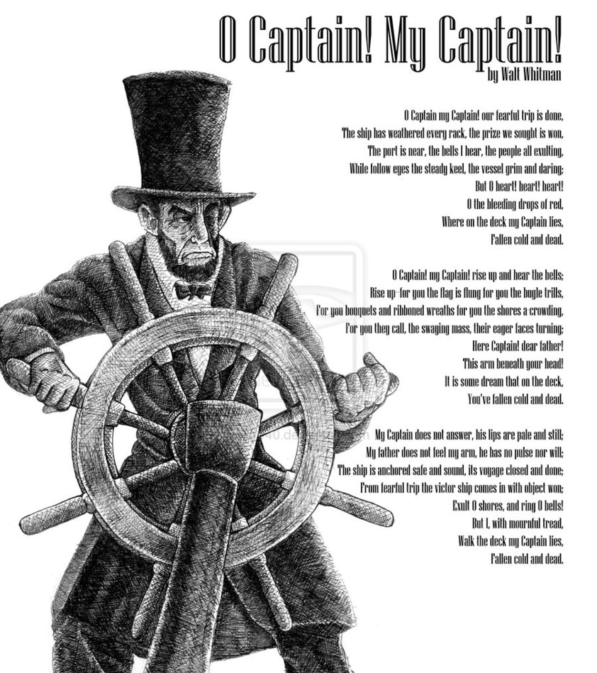
Elegy: A mournful or melancholy poem that honors someone who is dead.

Slide 34
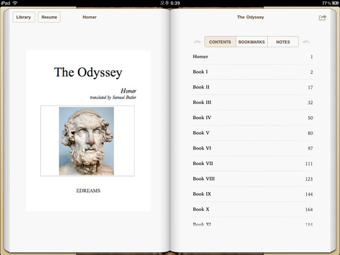
Epic: A long narrative poem that celebrates a hero or a heroic act.

Slide 35
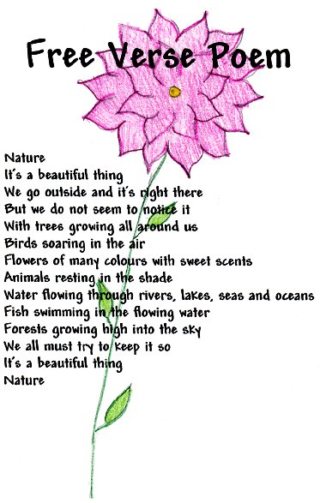
Free Verse: Poetry that has no fixed pattern of meter, rhyme, line-length, or stanza-arrangement.

Slide 36
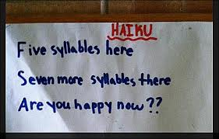
Haiku: A specific type of poetry that uses 3 lines and seventeen syllables.

Slide 37
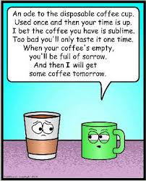
Ode: A lyrical poem; which is usually rhymed.

Slide 38
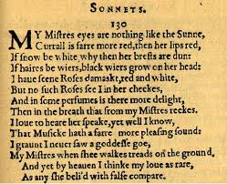
Sonnet: A poem containing 14 lines, usually written in iambic pentameter.

